Slide 1
Community, Respect & Equality Agreement
Notes:
Example discussion:
Acknowledgement of country
As an organisation we have recently signed on to the Community Respect & Equality Agreement (CRE) and will be going through this short presentation so that you are all aware of what the CRE Agreement is, and what is involved.

Slide 2
What is the CRE Agreement?
Midwest Multicultural Association
Notes:
Example Discussion:
The CRE Agreement is for organisations/businesses/schools/sporting clubs etc. to acknowledge and recognise family violence as being a key social and health issue. In signing on to the Agreement we will joining over 30 different organisations here in Geraldton to collectively say that #ViolenceIsNeverOk
The Agreement aims to highlight the need for a community approach to prevention, gather support for action that stops family violence and inspire people to act at an organisational level to eliminate the attitudes that support family violence.

Slide 3
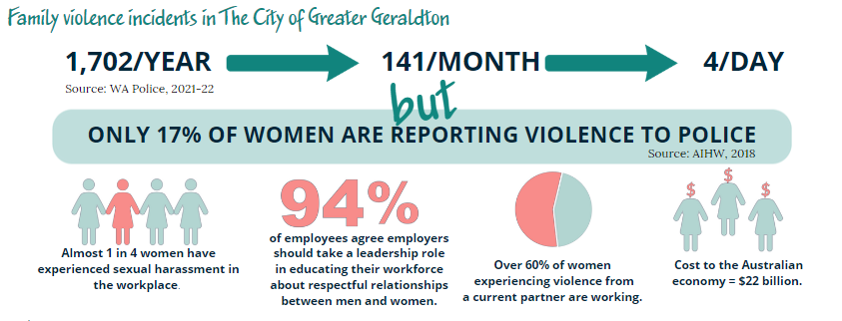
Why do we need the CRE Agreement?
`
Notes:
Example discussion:
in the City of Greater Geraldton alone there has been 1702 reported cases of family violence in the previous year, this works out to being 141 a month and 4 incidents a day.
Considering that only 17% of women who are experience violence from a current partner contact police, it is likely that these numbers are much, much higher.
Nationally one women is killed by a current or former partner nearly every week.
The attitudes and behaviours that support family violence occur in workplaces with 2 in 5 women having experienced sexual harassment in the workplace (Safe Work Australia/Australian Human Rights 2018 National Survey)
With 60% of Australian women who experience violence by a current partner being in paid employment, family violence is costing the Australian economy an estimated $22 billion each year, and with 94% of employees agreeing that employers should take a leadership role in educating their workplace about respectful relationships between men and women - we have a role to play in supporting our staff and colleagues who may be affected by family violence, whilst also ensuring our workplace takes action in addressing the underlying causes of family violence.
Furthermore Family Violence has a huge impact on productivity and costs to the Employer, with employers incurring 6% of the total cost of violence against women from an intimate partner (PWC A High Price To Pay Report, 2015)

Slide 4
Background behind the CRE Agreement
Notes:
Example discussion:
The CRE Agreement is a component of the wider CRE Project, which is based on the change the story shared framework for prevention of violence against women. The project acknowledges that while both men and women experience family violence, women are overwhelming impacted and are a greater risk of experiencing server injury, fear and death. This is why the CRE project uses a gendered lens at looking at family violence, whilst also acknowledging that violence can affect anyone and everyone in the community.
Here is a short video that describes how disrespect towards women leads to the attitudes and behaviours that support family violence becoming accepted in society.
Video options:
https://www.youtube.com/watch?v=fLUVWZvVZXw – Let’s change the story: Violence against women in Australia (4:27)
https://www.youtube.com/watch?v=tB7Pkcue9Rk&t=106s – It’s time to act on Our Watch (4:02)
https://www.youtube.com/watch?v=kIelQO2V2UY – More than a spectator (1:13)
https://www.youtube.com/watch?v=tp1X2ZOmmz8 – Violence against women: Sport can help change the story (3:29)

Slide 5
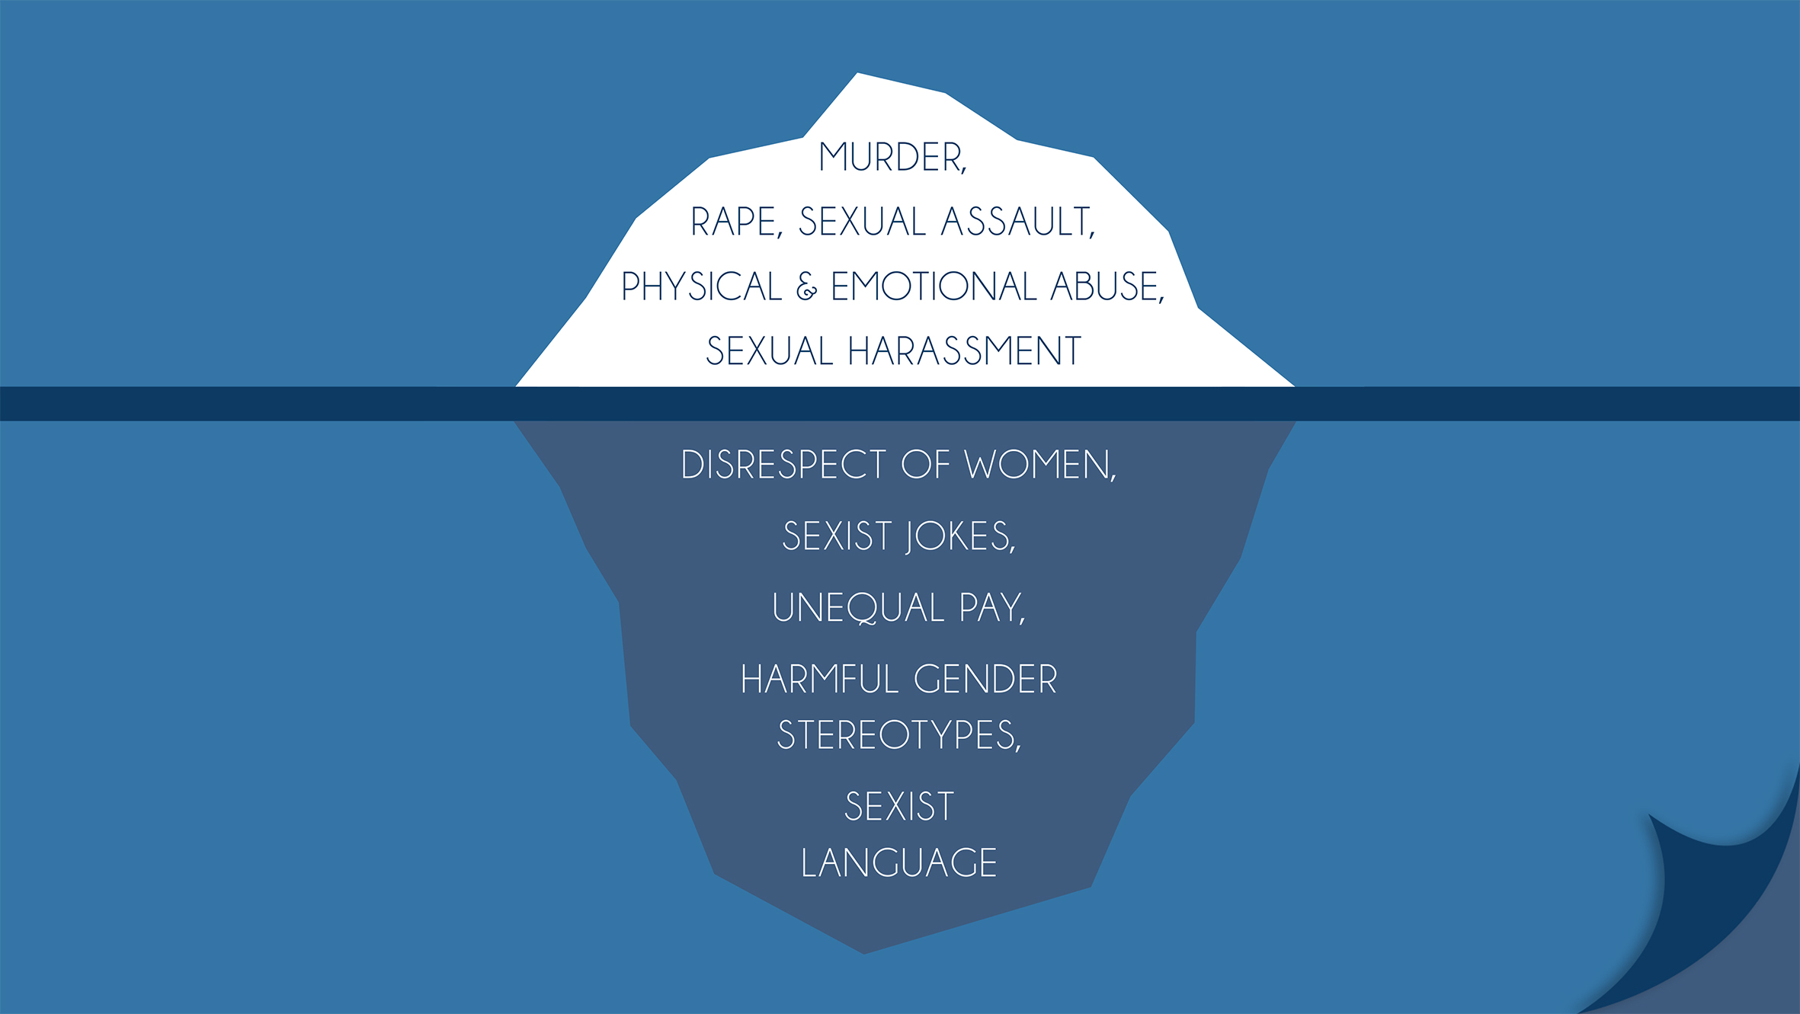
Underlying causes of Family Violence
Notes:
Example discussion:
As we can see in this iceberg image, it is the underlying sexist language, harmful gender stereotypes, unequal pay, sexist jokes and disrespect of women that lie under surface, but it are these social norms that build up and supports the tip of the iceberg that is the sexual harassment, physical and emotional abuse, sexual assault, rape and murder. This is why we need to work to address what lies under the surface, in order to prevent the tip of the iceberg emerging.

Slide 6
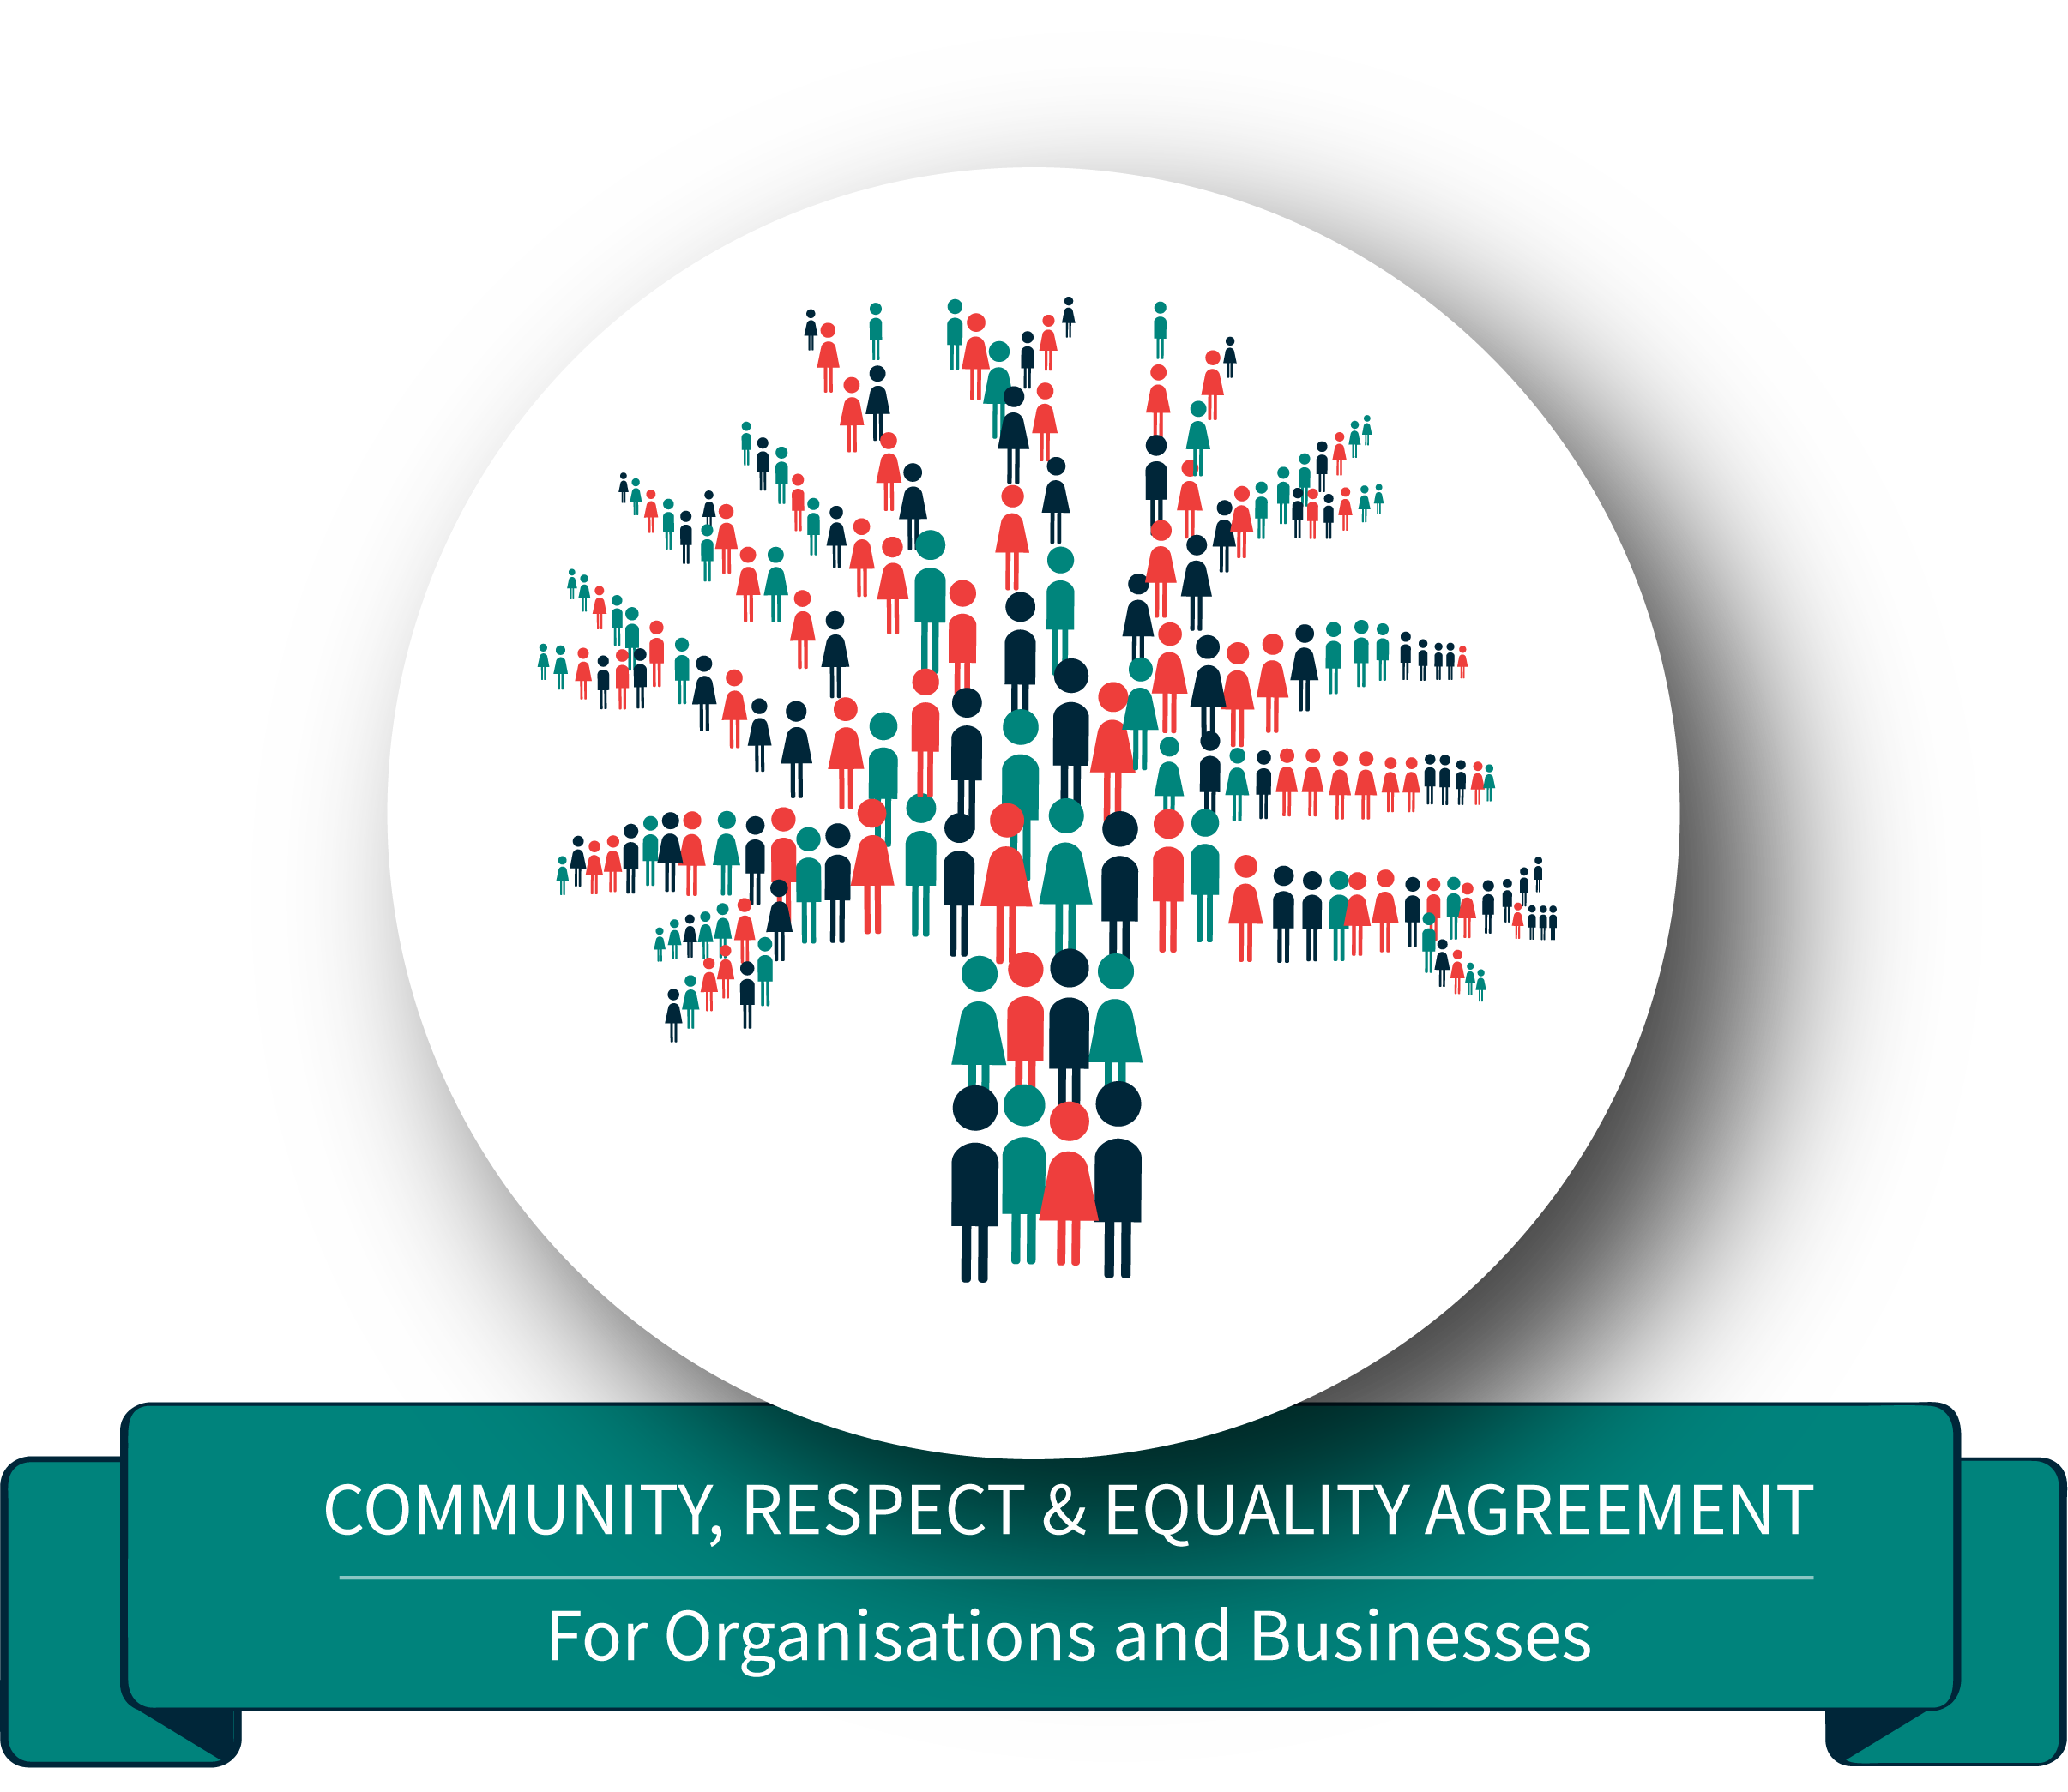
Why have we signed up?
Add organisations own quote as to
why you have decided to sign up.
Notes:
In your own words explain why as an organisation you felt it was important to sign onto the CRE Agreement.
Example discussion:
We signed up to show that as an organisation we want to be part of the change, and to stand up against these attitudes and behaviours that support family violence. We want everyone within our workplace to feel safe, respected and to be treated equally.

Slide 7
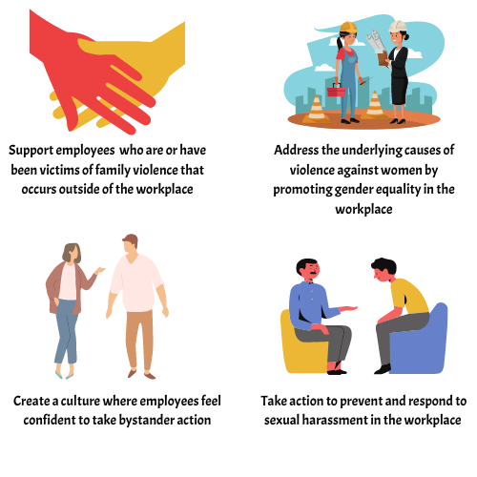
What we can do
Notes:
Example discussion:
In signing up we will be working towards:
Supporting employees who are or who have experienced family violence, this could be by:
Developing an organisational ‘responding to family violence’ policy
Training staff who have management responsibilities on how to respond to disclosures of family violence and support any employees who may be experiencing family violence to help them stay at work
Taking action to prevent and respond to sexual harassment in the workplace
Ensuring all staff understand what sexual harassment looks like and what harassing behaviours are most common
Actively promote and implement policies around equal opportunity, diversity, and the prevention of sexual harassment and sex discrimination at work.
If you see or hear something that makes you think a workmate might be experiencing sexual harassment, tell them you’ve noticed and ask what you can do to help.
Addressing the underlying causes of violence against women by promoting gender equity in the workplace
Conducting a gender audit to bring to light the ways in which your organisational polices and practices might be inadvertently having a negative impact on women, men, and gender equity.
Look at your attitudes towards and expectations of women and men at work. Are we treating women and men differently in the workplace? Do we expect men and women to do different kinds of tasks, like assuming that female staff will organise all the social functions or clean up after?
Promote flexible work practices at all levels of the organisation, because supporting women and men who have family or other caring responsibilities will have a positive impact on creating an equal and more productive workplace.
Create a culture where employees feel confident to take bystander action
We are going to take reports of discrimination, harassment or violence seriously and actively encourage staff to bring these issues to our attention
If someone makes a sexist or racist comment or joke at work, say something. You’re probably not the only one who thinks it’s wrong. Let the person know what they said is unacceptable and get the support of your colleagues.

Slide 8
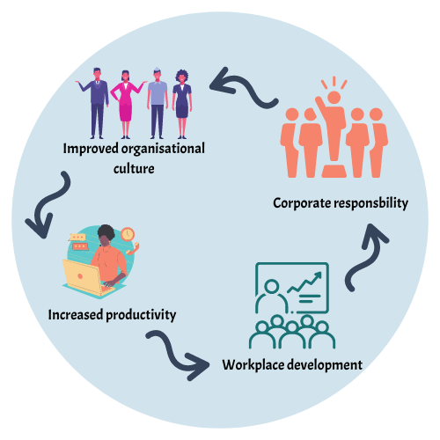
Benefits of taking action
It could be happening in our workplace
It’s costing our businesses
We all deserve to be safe at work
Notes:
Example discussion:
As we touched on before the attitudes and behaviours that contribute to family violence, occur in workplaces, and it is likely that our staff have been or are currently being impacted by family violence. Family violence is preventable and organisations can play a critical role in making change and providing a safe and healthy workplace.
There is also a lot of benefits for us as an organisation including (maybe just pick the key ones that resonate with your workplace the best):
Improved organisational culture
Increase in employee morale – we want you all to enjoy working here
Shared understanding of respectful relationships, and employees feeling respected and valued
Having available support for those who are experiencing FV
Increased productivity
We know if employee morale is high, than staff are likely to be more productive
And this also results in being able to attain and retain quality employees
Workplace development
We want to be able to educate and upskill employees on FV and where to get help (can do this via inclusion of FV information in induction packages and around the office)
Integrating best practice interventions into the workplace
Being able to review our policies to reflect gender equity
Providing a workplace that is safe for all people
Corporate responsibility
Create a socially responsible organisation
Being a role model as a regional leader in prevention of FV –can bring significant positive media exposure for the organisation or business, which will attract more quality employees as discussed, help us attain more funding, and attract clients, as people want to support organisations who are socially responsible.

Slide 9
What is involved? Agreed Values & Codes of Behaviour
Notes:
Example discussion:
So by signing on to the CRE Agreement, we need to adopt and embedded these Agreed Values and Codes of Behaviour into our workplace:
Community collaboration – standing up, speaking out and working together with others for a violence free community – this really important as it can’t just be one organisations working to prevent family violence, it needs to across the community to truly create change
Respect and cultural diversity – acknowledging and valuing traditions and cultural differences that do not infringe on human rights, and demonstrate respectful relationships with family, friends, work colleagues and other community members
Equality –supporting gender equality by promoting women’s independence and decision making in the workplace – we want to be working towards having women on the board and in leadership positions
Safety – promoting non-violent attitudes, language and behaviour to create a safer workplace and community – making sure mangers are leading by example and we will be taking harassment reports seriously
Social justice –working together to address unequal norms, practices and structures that lead to family violence – looking at the policies and practices within the workplace and see how they could be gendered bias
State how this are going to be embedded e.g. displayed around the workplace, included in induction packages, altering the organisations current values etc.

Slide 10
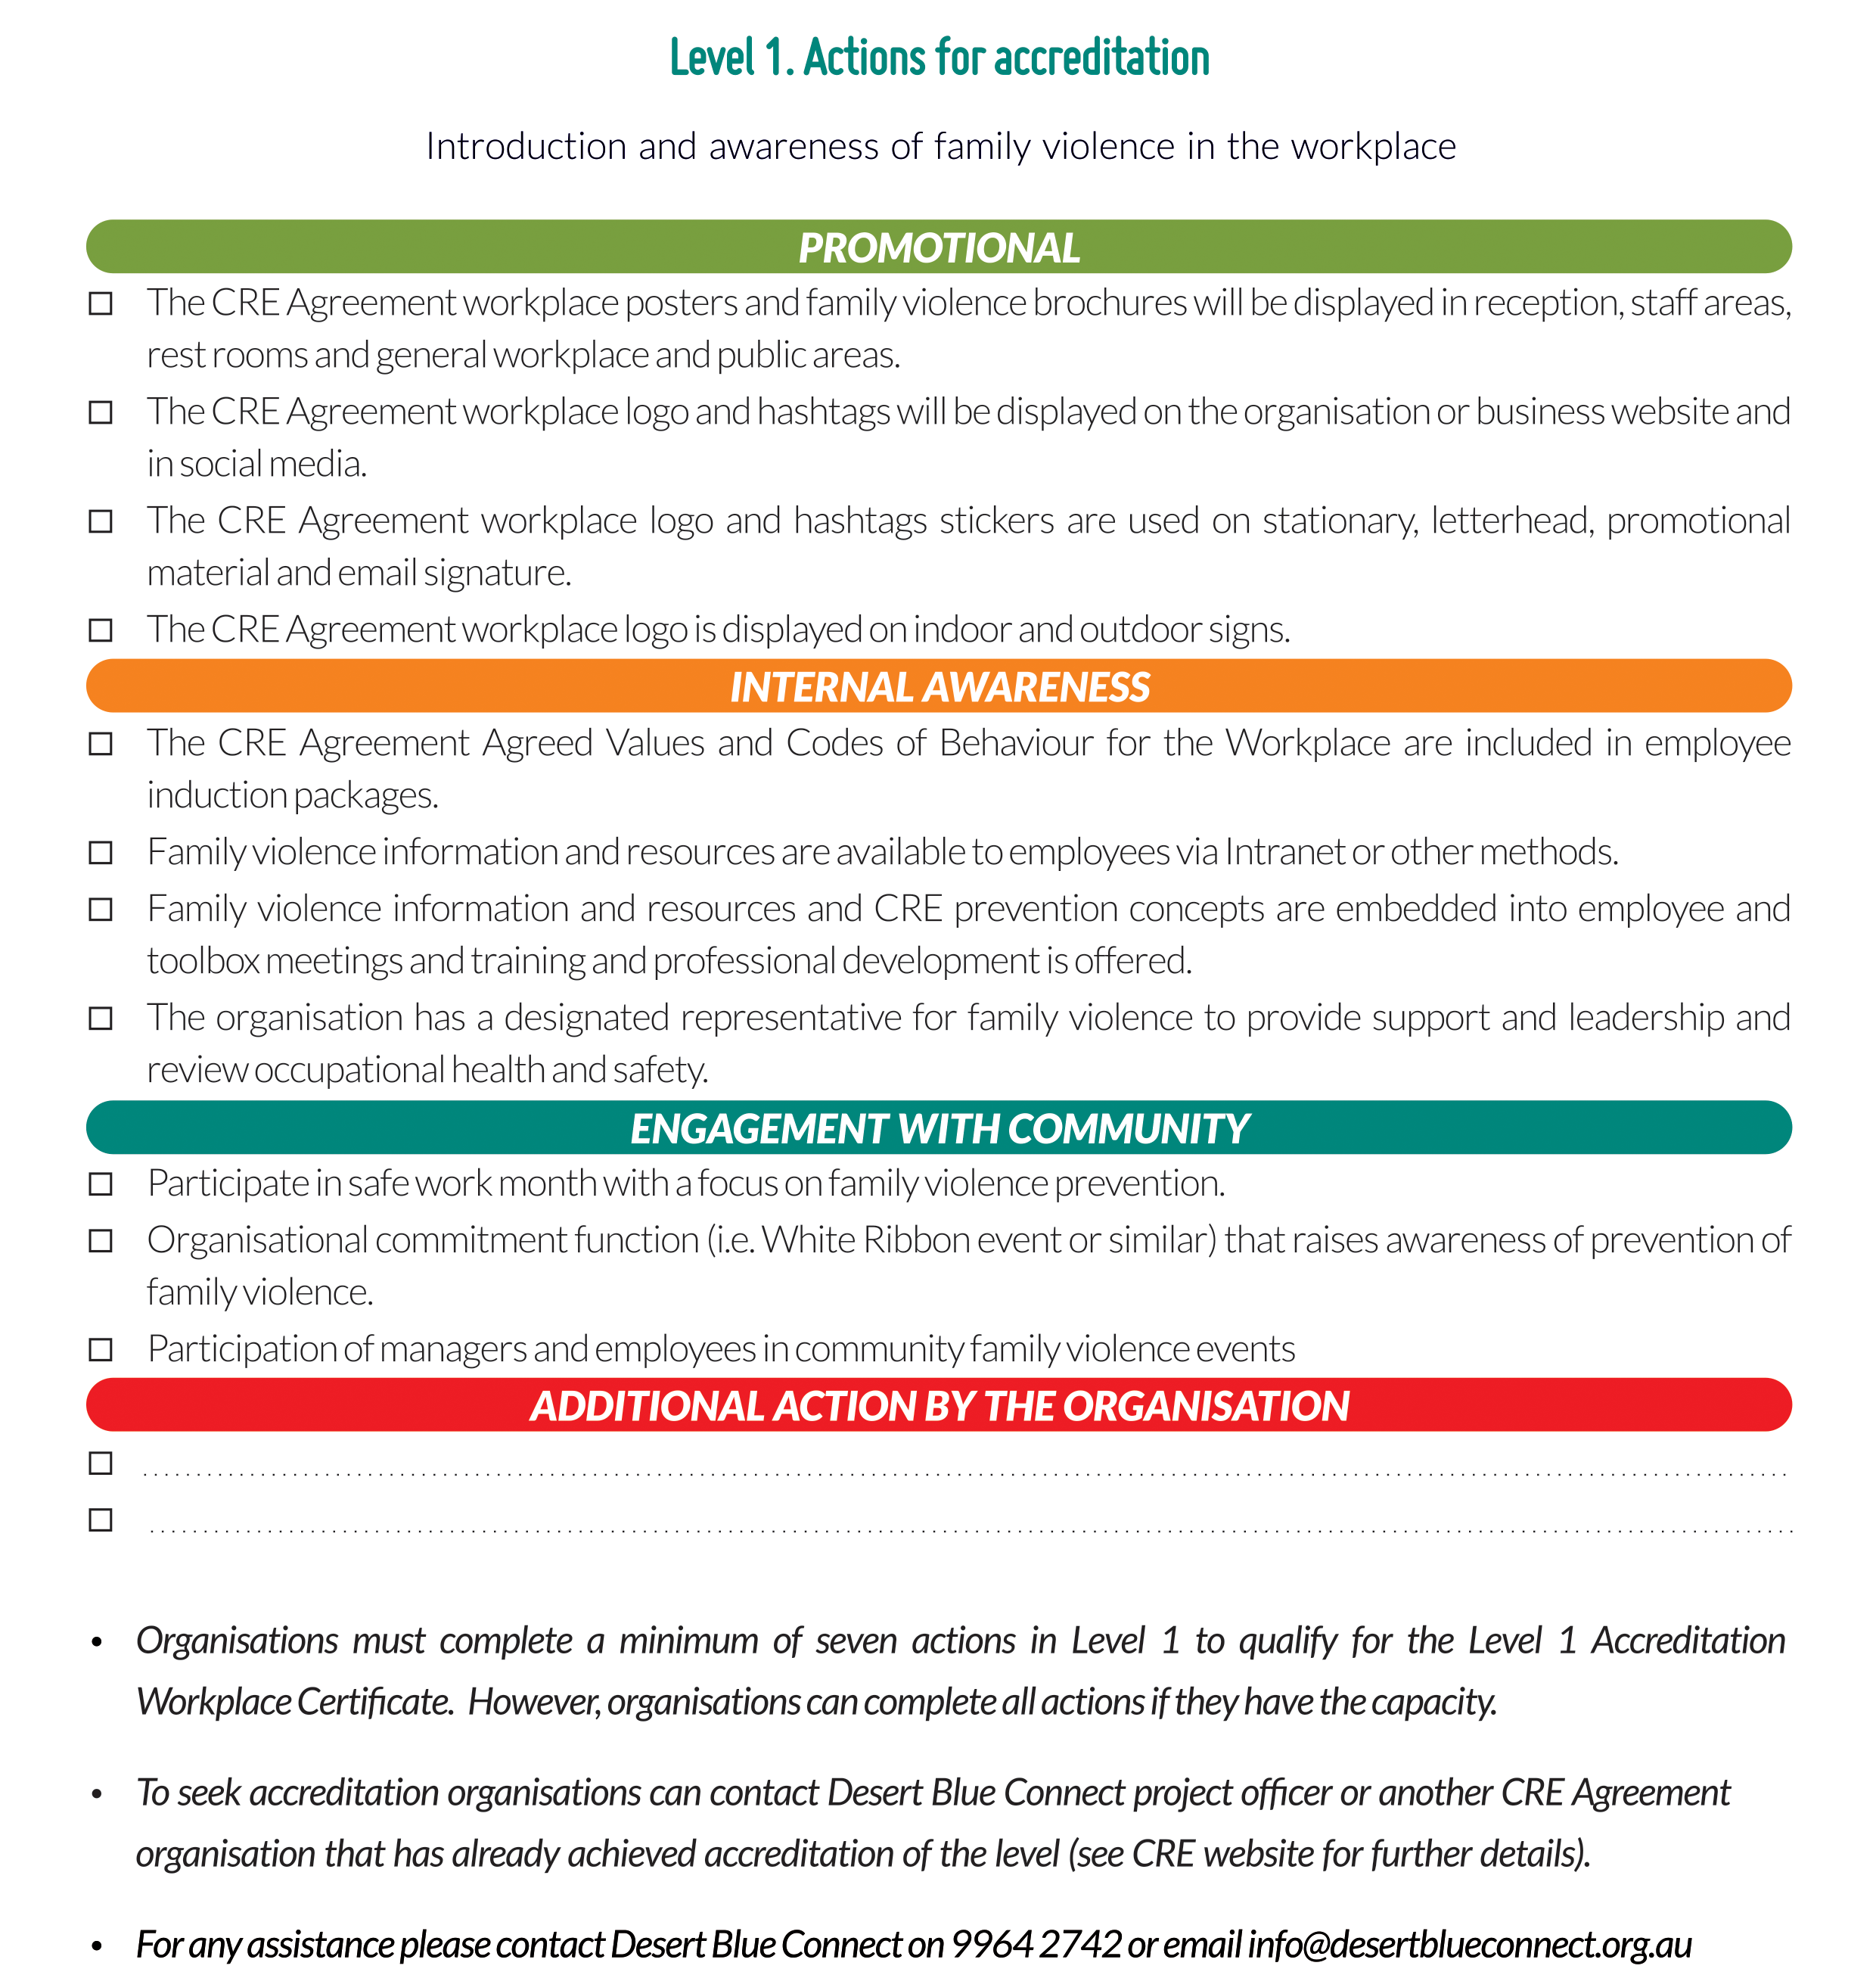
What is involved? CRE Accreditation
Notes:
Example Discussion:
There is also an accreditation process involved, so we must try to meet seven of the suggested actions here, or come up with our own ideas in order to become accredited in level 1 (level 2 and 3 will be developed in the future).
Print checklist out from here:
Allow staff to brainstorm ideas of ways to meet the suggested actions and come up with ideas for additional actions that may be unique for the organisation. Try to prioritise/delegate different actions among staff members/designate someone to lead actions of the agreement. Set another meeting time (or add the CRE Agreement to regular team meeting agendas) to be reviewed and discussed further.

Slide 11
Support is available
Desert Blue Connect provides services in the areas of family violence, women’s health, primary prevention, emergency accommodation for women and children, and rural support services.
Chrysalis House Women’s Refuge: (08) 9964 2173
Sexual Assault Crisis Line: 1800 016 798
Main Office: (08) 9964 2742
If you or someone you know is impacted by sexual assault, domestic or family violence call: 1800-RESPECT (1800 737 732)
Women’s Domestic Violence Helpline
24/7 Counselling, support and referrals for victims of family and domestic violence, including to refugees or other accommodation support
(08) 9223 1188 or free call 1800 007 339
Men’s Domestic Violence Helpline
Provides 24/7 counselling and referrals for male perpetrators, as well as male victims of family and domestic violence.
(08) 9223 1199 or free call 1800 000 599
Notes:
Example Discussion:
If anything we have discussed today has raised any concerns for you, please reach out for support.
Discuss services, but also how your own workplace can provide support/suggest appropriate person to contact, or what you may be putting in place to support employees experiencing family violence in the furture (may have been touched on in previous brainstorm).
There is Desert Blue Connect in town
Desert Blue Connect provides services in the areas of family violence, women’s health, primary prevention, emergency accommodation for women and children, and rural support services.
Chrysalis House Women’s Refuge: (08) 9964 2173
Sexual Assault Crisis Line: 1800 016 798
Main Office: (08) 9964 2742
Website: www.desertblueconnect.org.au
1800-RESPECT
If you or someone you know is impacted by sexual assault, domestic or family violence call:
1800-RESPECT (1800 737 732)
Website: www.1800respect.org.au
Women’s Domestic Violence Helpline
24/7 Counselling, support and referrals for victims of family and domestic violence, including to refugees or other accommodation support
(08) 9223 1188 or free call 1800 007 339
Men’s Domestic Violence Helpline
Provides 24/7 counselling and referrals for male perpetrators, as well as male victims of family and domestic violence.
(08) 9223 1199 or free call 1800 000 599

Slide 12
Any Questions?
For more information please contact us
9964 2742 or info@communityrespectandequality.com.au
All documents and information are also available on our website: www.communityrespectandequality.com.au

Slide 13
References
Australian Bureau of Statistics. ‘Personal Safety Survey’, cat.49606.0, Canberra, 2006. Retrieved from: http://www.abs.gov.au/ausstats/abs@nsf/7d12b0f6763c78caca257061001cc588/858badad39afb98dca2571b000153d73!OpenDocument
PWC. (2015) The economic case for preventing violence against women – A high price to pay. Retrieved from https://www.pwc.com.au/pdf/a-high-price-to-pay.pdf
OurWatch, VicHealth, & ANROWS. (2015). Change the story: A shared framework for the prevention of violence against women and their children in Australia. Retrieved from https://www.ourwatch.org.au/getmedia/0aa0109b-6b03-43f2-85fe-a9f5ec92ae4e/Change-the-story-framework-prevent-violence-women-children-AA-new.pdf.aspx
OurWatch. (2018). Preventing violence at work. Retrieved from https://www.ourwatch.org.au/Preventing-Violence/Professionals/At-work
OurWatch. (2020). Understanding Violence Against Women. Retrieved from https://workplace.ourwatch.org.au/why-do-this-work/understanding-violence-against-women/
Victoria Health [VicHealth]. (2012). Preventing violence against women in the workplace (An evidence review: summary report), Victorian Health Promotion Foundation, Melbourne, Australia. Retrieved from https://www.vichealth.vic.gov.au/~/media/ResourceCentre/PublicationsandResources/Economic%20participation/2012%20workplace/VH_Preventing_violence_against_women_09.pdf 19B4F8CE8090D55F6F8F020030F

